Slide 1
RAM Drives
By George Skarbek
April 2019

Slide 2
What is a RAM drive
A RAM drive is a part of assigned memory that appears to the operating system as an amazingly fast hard drive.
It can be also called a RAM disk.
It is very, very fast.

Slide 3
Why use a RAM drive - #1
Unused memory can be used to improve productivity by creating a RAM drive which appears as a physical drive that is VASTLY faster than a conventional hard disk or a SSD.
There is no latency so you do not have to wait for the drive’s sector to move over the read/write head.
There is no measurable seek time either.

Slide 4
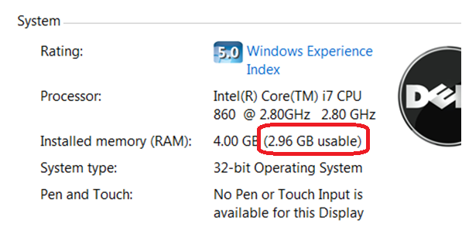
Why use a RAM drive - #2
On all computers with 4 GB RAM and over and running a 32 bit operating system, typically memory over about 3.3 GB is not used due to reserved memory for the BIOS. The rest is wasted!

Slide 5
Why use a RAM drive - #3
In all versions of Windows using RAM drive for the temp files gives the following benefits:
    Reducing the amount of data written is especially important in extending the life of an SSD.
    Saves space and wear on drive C and reduces noise.
  There is no contention on the read/write heads when temp files are created, such as when opening Word.
  Provide very much faster file access.
  No cleaning up required of temp files as all contents are lost on a reboot.

Slide 6
Why use a RAM drive – #4
Reduces fragmentation on drive C.
Saves time and disk space when doing an image backup as junk files are not backed up. I have seen over 50,000+ files in Temp folders and thousands of folders (not the Temporary Internet folders).
These also should be placed on a RAM drive.
Use it for timing HD & USB performance.

Slide 7
Why use a RAM drive - #5
Memory prices fluctuate a lot and 4 GB costs about $50 today.
Put not only the temp files on the RAM drive but also the cache files from IE, Firefox and Chrome (less junk to back up with Acronis).
You can use the RAM drive for testing software. No cleaning up afterwards.
When sharing folders, using a RAM drive is more secure. If a hacker gets in, drive C will not be accessible.

Slide 8
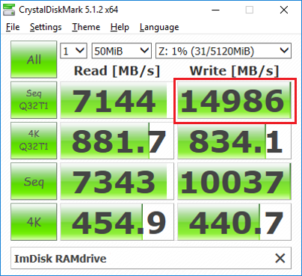
How fast is it?
Insanely fast!
On a nearly 2 year old
Ryzen 1700X

Slide 9
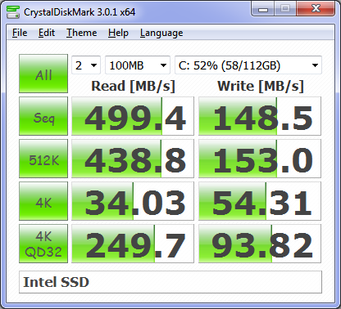
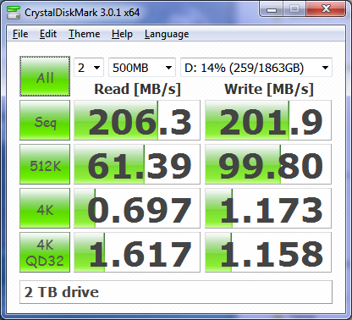
Compared to
  A good SSD A 2TB drive

Slide 10
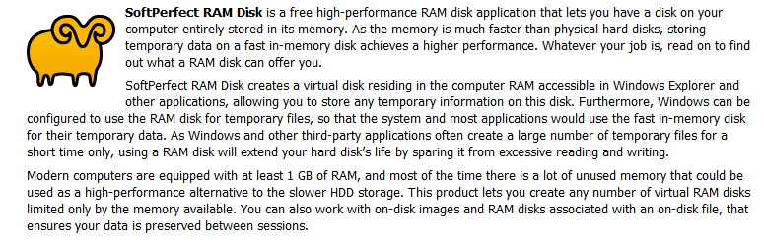
How do you create one?
There are many free RAM drive programs for both 32 and 64 bit operating systems. The free versions are generally limited to a maximum of 4 GB.
SoftPerfect is free, unrestricted and very fast. It will create a temp folder, set the environment and a drive letter, say drive Z.
www.softperfect.com/products/ramdisk

Slide 11
Finding RAM Drive software
The best free RAM Disk programs for Windows Reviewed by Martin Brinkmann on April 03, 2017
See: https://www.ghacks.net/2017/04/03/the-best-free-ramdisk-programs-for-windows/
There are many free programs. Some are restricted to under 4 GB.

Slide 12
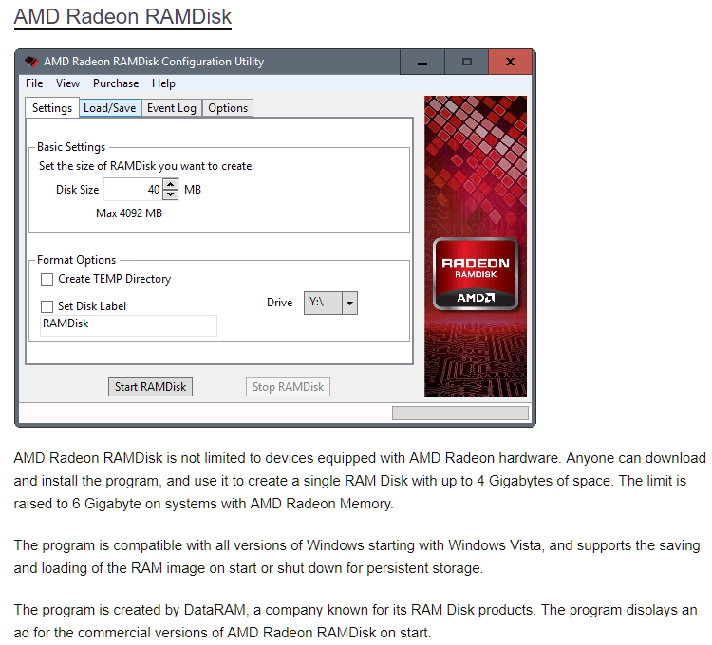
One example from previous link

Slide 13
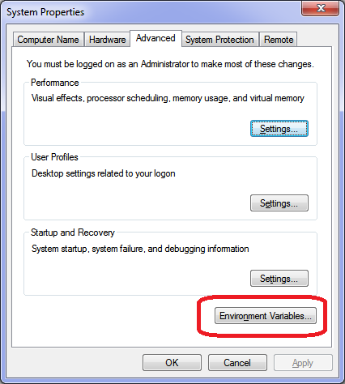
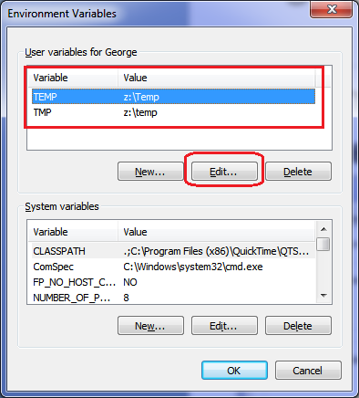
Setting the environmental variables
From Control Panel, System, click on Advanced system settings then alter as shown

Slide 14
Putting browser temp files there
For IE click on Tools, Internet Options, Browsing History and Move etc.
For Firefox type about:config into the Firefox navigation bar and hit enter. Next find the browser.cache.disk.parent_directory. If it doesn't exist right click anywhere and select New, String. Enter browser.cache.disk.parent_directory in the first popup box and then the location in the 2nd popup box e.g. Z:\temp. If the entry already existed simply right click and modify it.

Slide 15
Putting Chrome temp files there
For Google Chrome, create a directory symbolic link from the DOS box with admin rights.
cd “C:\Users\George\AppData\Local\Google\Chrome\User Data\Profile 1\Cache”
Dir (This command is to confirm the folder)
del *.* (Delete everything)
cd.. (Go up one level)
rd cache (Remove the folder)
All of the above can be done using Windows Explorer. The next step can only be done from the admin DOS box.
mklink /d "C:\Users\George\AppData\Local\Google\Chrome\User Data\Profile 1\Cache" z:\Temp

Slide 16
Putting Edge temp files there
This is very difficult to do as Microsoft made some fundamental steps to make the operating system (Windows) use the symbolic link method which is not easily achievable for that folder.
A lot of in-depth knowledge of defeating Windows security is required.
May not be worth the effort.

Slide 17
Possible operational problems
Only possible drawback is the temp folder filling if the computer is never re-booted or if installing some massive program such as Full Adobe suite with all options.
Fix by temporarily using a hard drive for temp files.
But with a 4 GB RAM drive this is not going to be a problem as the Temp folder will not fill.

Slide 18
The Swapfile location
Do NOT put the Swapfile onto the RAM drive if you use a 64 bit operating system.
With a 32 bit operating system and 8+ GB of RAM the swapfile can be placed on the RAM drive.
Do NOT set Readyboost to the RAM drive as this will not be active until Windows starts, defeating is purpose.

Slide 19
Any Questions?

